Slide 1
HBASE
HBase is a distributed column-oriented database built on top of the Hadoop file system. It is an open-source project and is horizontally scalable.
HBase is a data model that is similar to Google’s big table designed to provide quick random access to huge amounts of structured data. It leverages the fault tolerance provided by the Hadoop File System (HDFS).
It is a part of the Hadoop ecosystem that provides random real-time read/write access to data in the Hadoop File System.
One can store the data in HDFS either directly or through HBase. Data consumer reads/accesses the data in HDFS randomly using HBase. HBase sits on top of the Hadoop File System and provides read and write access.

Slide 2
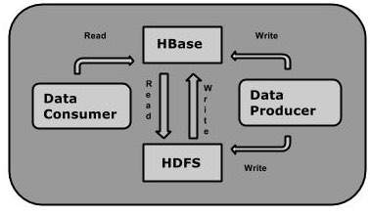

Slide 3
1 Introduction to HBase Architecture
HBase Architecture Components Explanation
2.1 HBase Master Server
2.2 HBase Regions
2.3 HBase Region Server
2.4 HBase MemStore
2.5 HBase Hfiles
2.6 Zookeeper

Slide 4
Introduction to HBase Architecture
HBase architecture mainly consists of three components-
• Client Library • Master Server • Region Server
HBase tables are mainly divided into regions and are being served by Region servers.

Slide 5
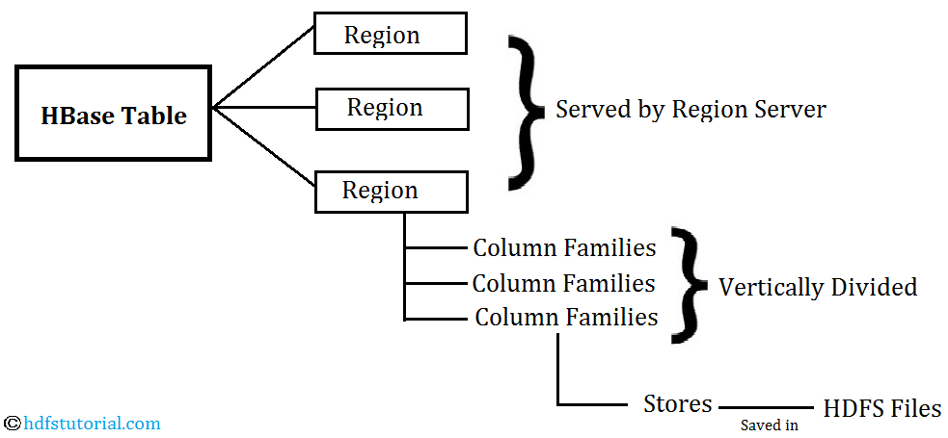

Slide 6
HBase Master Server
The main role of Master server in HBase architecture is as follows-
• Master server assigns region to region server with the help of Apache Zookeeper • It is also responsible for load balancing. With that mean, master server will unload the busy servers and assign that region to less occupied servers. • Responsible for schema changes like HBase table creation, the creation of column families etc. • Interface for creating, deleting, updating tables • Monitor all the region servers in the cluster

Slide 7
HBase Regions
HBase tables are divided horizontally into row-key range called “regions” and are managed by region server. So regions are nothing bit the tables that are split horizontally into regions.
Regions are assigned to a node in the cluster called Region server. A single region server can server around 1000 regions.

Slide 8
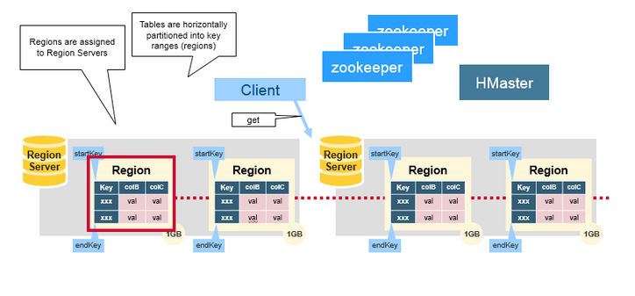
HBASE Region

Slide 9
HBase Region Server
Region server manages regions and runs on HDFS DataNodes. Many times in big data you will find the tables going beyond the configurable limit and in such cases, HBase system automatically splits the table and distributes the load to another Region Server.
The above process is called auto-sharding and is being done automatically in HBase till the time you have servers available in the rack.
Here are some of the important functions of Region server-
• It communicates with the client and handles data-related operation • Decide the size of the region • Handle the read and write request for all the regions under it.

Slide 10
HBase MemStore
HBase memstore is like the cache memory. When we want to write anything to HBase, first it is getting stores in memstore.
Later the data will be sent and saved in Hfiles as blocks and the memstore and memstore will get vanished. There will be one memstore per column family. When the memstore accumulates enough data then the entire data is transferred to Hfiles in HDFS.

Slide 11
HBase Hfiles
As said, whenever any data is being written into HBase, first that gets written into memstore. And when memstore accumulates enough data, the entire sorted key-value set is written into a new Hfiles in HDFS.
The write into HFile is sequential and is very fast.

Slide 12
Zookeeper
HBase uses Zookeeper as a coordinator service to maintain the server state in the cluster. It tells which servers are alive and available and also provides server failure notification.
If you are creating a table in HBase and it is showing you the error like server not enabled etc., check whether Zookeeper is up and running or now.
It also takes care of the network partitions and client communicate with regions through Zookeeper. In Standalone Hadoop and Pseudo-Distributed Hadoop modes, HBase alone will take care of Zookeeper.

Slide 13
Conclusion
HBase is an integral part of the Hadoop ecosystems and used very frequently as a NoSQL database especially when you need to do record level operation.

